Slide 1

INVESTMENT DECISION RECOMMENDATION
Kanishka Kannan

Slide 2
Table of Contents:
Introduction
Methodology
Findings
Recommendation System Performance
Conclusion

Slide 3
Introduction:
In today's rapidly changing financial landscape, making sound investment decisions is crucial for individuals seeking to secure their financial future. However, navigating the complexities of the investment world can be daunting, especially for those without expertise or experience in financial markets. To address this challenge, we present a recommendation system designed to assist individuals in making informed investment decisions based on their unique characteristics and preferences.
Objective:
The primary objective of our recommendation system is to leverage machine learning techniques to predict the best investment decision for new data samples, considering various factors available in the dataset. By analyzing demographic, employment, and behavioral characteristics, our system aims to identify patterns and correlations that contribute to successful investment outcomes.

Slide 4
Dataset Overview:
Our dataset contains comprehensive information about individuals and their investment behavior, encompassing a wide range of demographic, employment, and behavioral attributes. Through data exploration, we aim to gain insights into the distribution of demographic features such as gender, marital status, and age, as well as employment details including roles, career stages, and income brackets represented in the dataset. Additionally, we will delve into investment behavior insights such as the percentage of household income invested, sources of awareness about investments, knowledge levels, influencers, risk levels, and reasons for investment.
Recommendation System Development:
Our recommendation system will utilize state-of-the-art machine learning techniques to model the relationship between input variables and investment outcomes. We will explore algorithms such as decision trees, random forests, and neural networks to develop predictive models capable of identifying the best investment decisions for individuals based on their unique characteristics and preferences. The system will be evaluated using appropriate metrics such as accuracy, precision, recall, or F1-score to ensure its effectiveness and reliability.

Slide 5
Data Collection Process:
The dataset used for this analysis was obtained from an external source and contains comprehensive information about individuals and their investment behavior. It includes a wide range of demographic, employment, and behavioral attributes, providing valuable insights into the factors influencing investment decisions.
Preprocessing Steps:
Data Cleaning: The dataset underwent thorough cleaning to handle missing values and remove duplicate entries. Numerical columns were filled using forward fill method, while categorical columns were imputed with the mode value.
Label Encoding: Categorical variables such as 'Investment Experience', 'Percentage of Investment', and 'Return Earned' were encoded into numerical values using a label encoding technique. This conversion allows for better compatibility with machine learning algorithms.
Outliers Detection: Outliers were detected using both Z-score and Interquartile Range (IQR) methods. Outliers can significantly impact the performance of machine learning models, so it's essential to identify and address them appropriately.

Slide 6
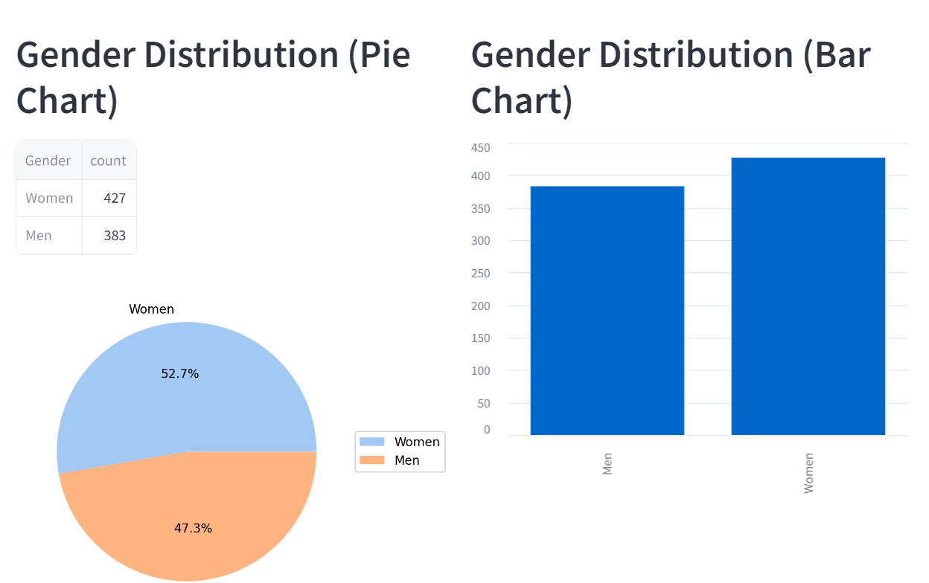
Exploration of Employment Details:
Employment Roles: The distribution of different employment roles among individuals was analyzed, providing insights into the diversity of occupations represented in the dataset.
Career Stages: The distribution of individuals across various career stages, represented by age groups, was explored. This analysis helps understand the demographics of the dataset and identify any age-related trends in investment behavior.
Income Brackets: The dataset includes information about household income brackets, allowing us to analyze the distribution of income levels among individuals. Understanding income demographics is crucial for tailoring investment recommendations to different financial profiles.

Slide 7
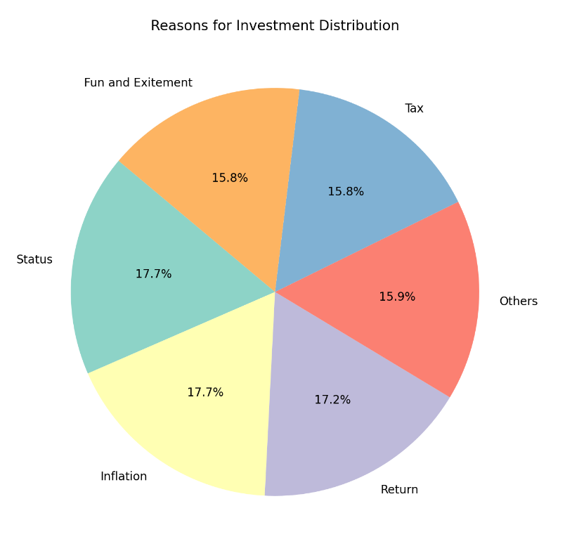
Demographic Distribution: Analysis revealed a diverse demographic distribution in terms of gender, marital status, and age, indicating a broad representation of individuals in the dataset.
Employment Insights: Exploration of employment details highlighted the variety of roles, career stages, and income brackets represented, providing valuable context for understanding individuals' financial backgrounds.
Investment Behavior Insights: Insights into investment behavior, including the percentage of household income invested, sources of awareness about investments, knowledge levels, influencers, risk levels, and reasons for investment, offer valuable insights into individuals' investment preferences and decision-making processes.

Slide 8
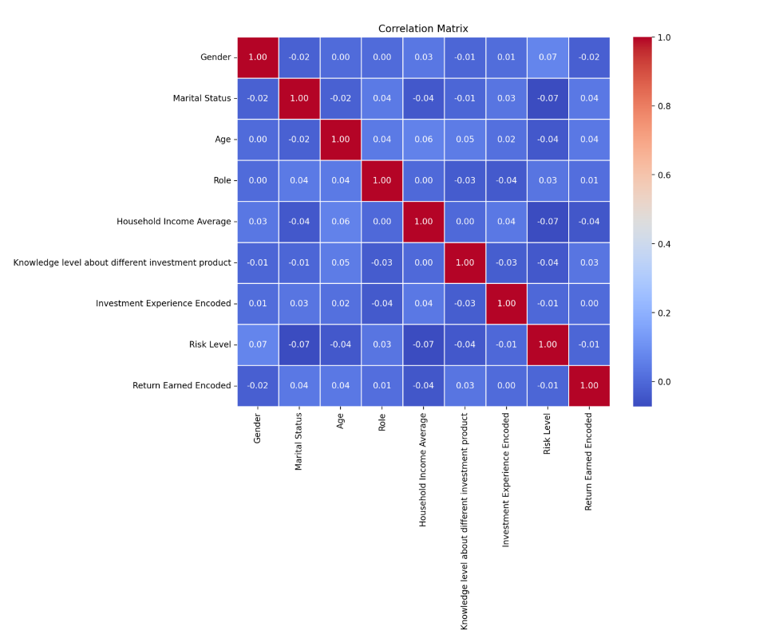
Correlation Analysis
Heatmap for the correlated demographic data
Feature selection:
For choosing important features heatmap is used and the factors are sorted to determine the feature importance.
The correlation matrix is built after doing appropriate label encoding.

Slide 9
Model Selection, Training, and Evaluation:
Model Selection:
Explored various machine learning models to build our recommendation system for predicting the best investment decision. The models considered were:
Decision Tree: A decision tree classifier was chosen for its interpretability and ability to handle both numerical and categorical data effectively. It splits the dataset into smaller subsets based on the most significant attributes.
Random Forest: Random Forest is an ensemble learning method that consists of multiple decision trees. It combines the predictions of multiple individual models to improve accuracy and reduce overfitting.
Neural Network: Neural networks, specifically Multi-Layer Perceptron (MLP), were selected for their capability to learn complex patterns in the data. Neural networks are known for their ability to capture intricate relationships between input features and target variables.

Slide 10
Training:
Decision Tree Training: We trained the decision tree classifier using the training data and evaluated its performance on the test set. The model was then fine-tuned using hyperparameter tuning techniques to improve its accuracy and generalization.
Random Forest Training: Similarly, we trained a Random Forest classifier with default hyperparameters and optimized it using GridSearchCV and RandomizedSearchCV to find the best combination of hyperparameters.
Neural Network Training: The neural network classifier was trained using the backpropagation algorithm with various optimizers such as Adam and Stochastic Gradient Descent (SGD).And also ensemble techniques like AdaBoosting and GradientBoosting
Feature Importance :
We have determined the feature importance of the model with the plot depicting the model coefficients

Slide 11
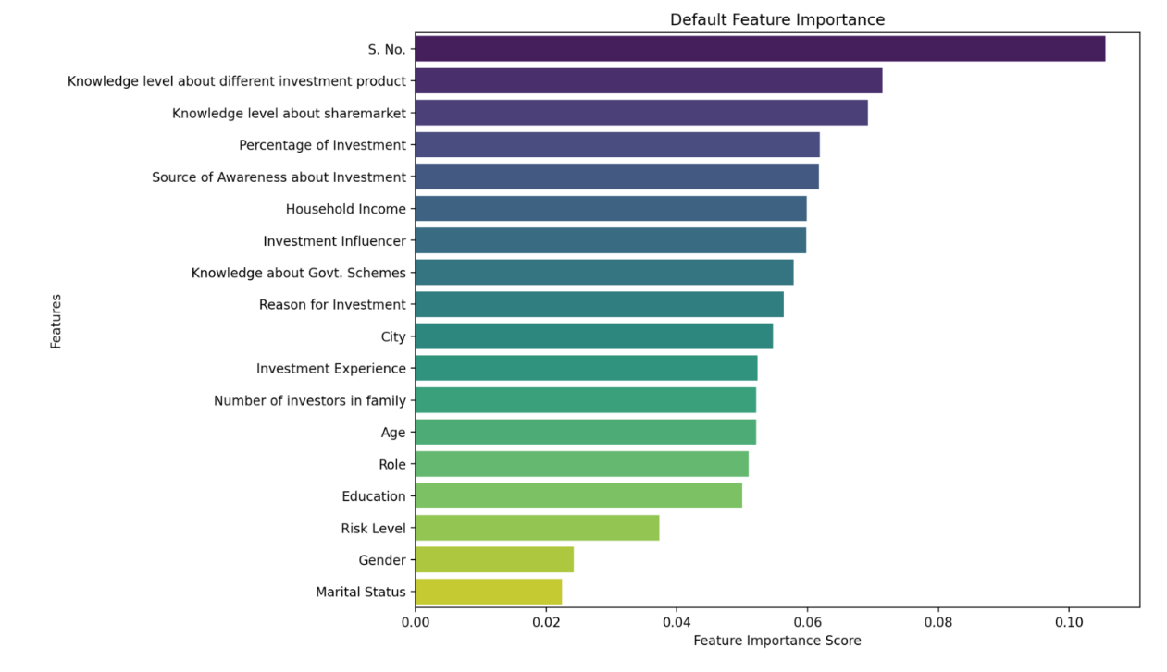

Slide 12
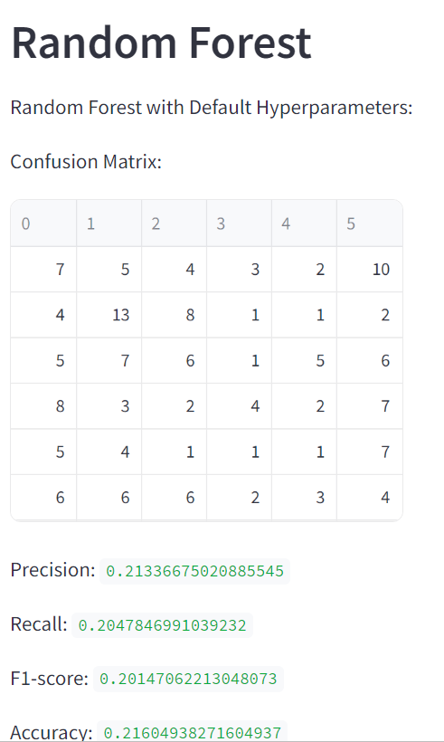
Evaluation metrics used
Accuracy: We evaluated the performance of each model using metrics such as accuracy, precision, recall, and F1-score. Accuracy measures the proportion of correctly classified instances out of the total instances.
Confusion Matrix: The confusion matrix provided insights into the model's performance by showing the number of true positives, true negatives, false positives, and false negatives.
Feature Importance: We analyzed the importance of input features in predicting the target variable using techniques like Gini importance for decision trees and feature importances for Random Forest.
Cross-Validation: Cross-validation was performed to assess the generalization ability of the models. We used k-fold cross-validation to split the data into training and validation sets multiple times, calculating the average performance across folds.
Model Comparison: Finally, we compared the performance of different models to select the best-performing one for our recommendation system. The chosen model demonstrated superior accuracy and robustness in predicting investment decisions

Slide 13
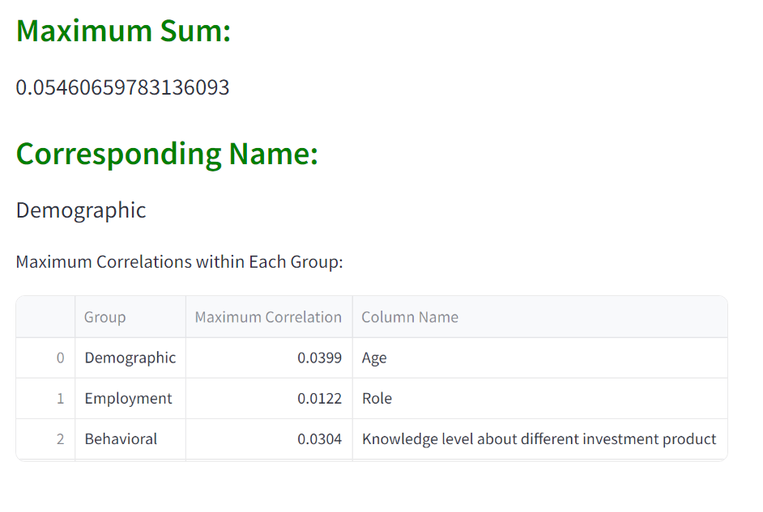
INSIGHTS

Slide 14
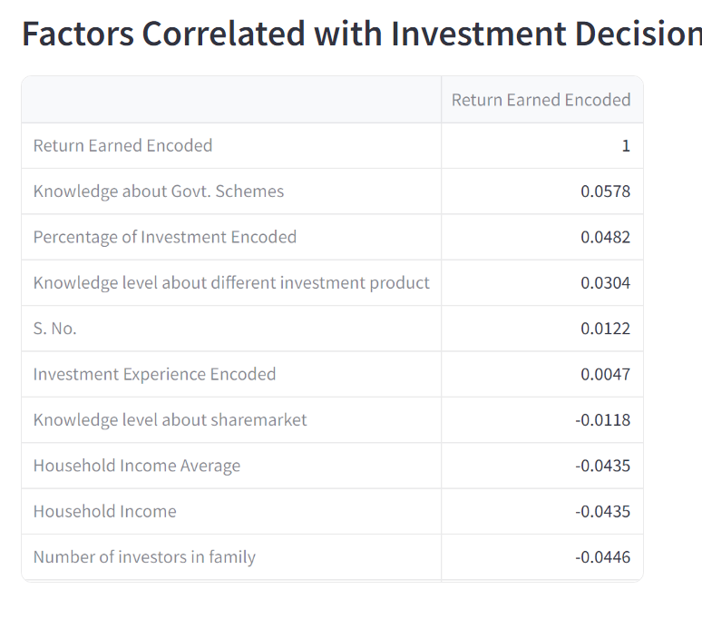

Slide 15
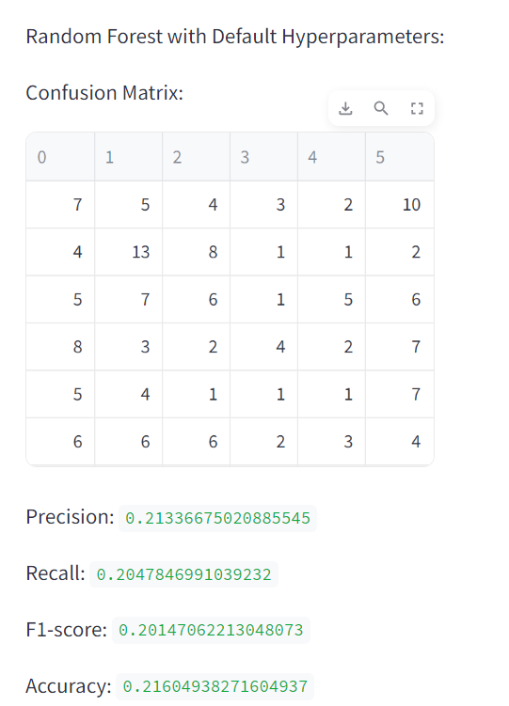
Model performance
ACCURACY-21.6 %

Slide 16
THANK YOU

